Slide 1
Stress and coronary heart diseases
three specific problems
in research
蒋捷宇 11307120074

Slide 2
Glossary
Coronary heart disease (CHD) 慢性心脏病
Follow-up 随访
Hazard ratio 风险率
Meta-analysis 荟萃分析
Antecedents 前因

Slide 3
Identify the stress
Child
Abuse
Parental disease
Poor socioeconomic circumstance
Adult
Work stress
Sick spouse
Death of kids

Slide 4
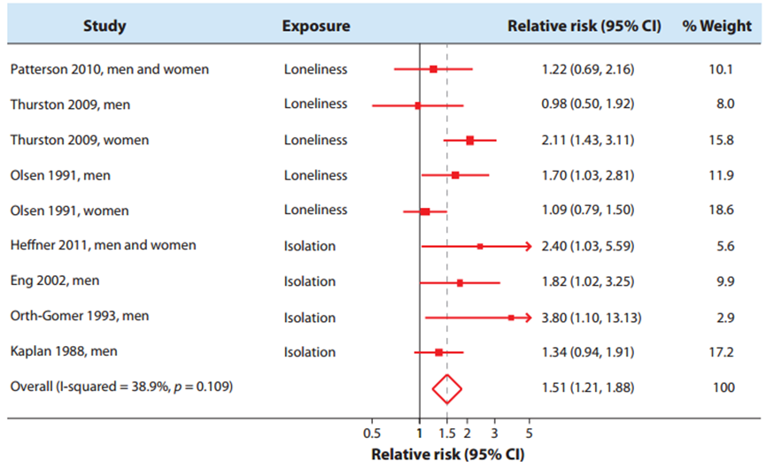

Slide 5
Pre-clinical CHD sufferers
Who get CHD soon after stress assessment
Reduce working hours
Low stress level
Get CHD

Slide 6
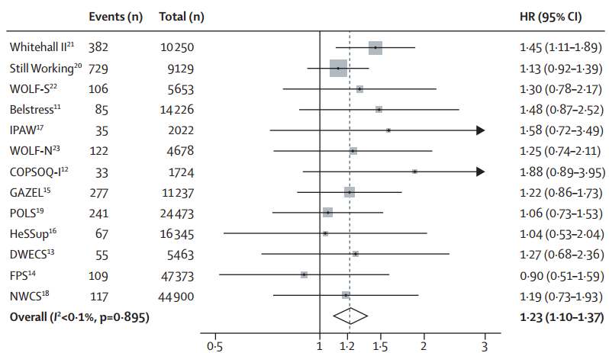
Solution

Slide 7
”Common soil” hypothesis
Common
soil
Common antecedents
Pathophysiological
Behavioral
Environmental
Stress
CHD

Slide 8
Solution
Cause of CHD
Trigger for heart attacks
Poor prognostic indicator

Slide 9
Take home message
Identify the stress
Troublemakers
”Common soil” hypothesis
Specific start point
Confounders
Logic tricks

Slide 10
Reference
Kivimaki, M., et al., Job strain as a risk factor for coronary heart disease: a collaborative meta-analysis of individual participant data. Lancet, 2012. 380(9852): p. 1491-7.
Virtanen, M., et al., Overtime work and incident coronary heart disease: the Whitehall II prospective cohort study. Eur Heart J, 2010. 31(14): p. 1737-44.
Steptoe, A. and M. Kivimaki, Stress and cardiovascular disease. Nat Rev Cardiol, 2012. 9(6): p. 360-70.
Steptoe, A. and M. Kivimaki, Stress and cardiovascular disease: an update on current knowledge. Annu Rev Public Health, 2013. 34: p. 337-54.
Sokejima, S. and S. Kagamimori, Working hours as a risk factor for acute myocardial infarction in Japan: case-control study. BMJ, 1998. 317(7161): p. 775-80.

Slide 11
Thank You！

