Slide 1
西方美学经典导读——康德的美学思想
美的分析论
——《判断力批判》美者分析论第一、二契机
杜洁 10300110043

Slide 2
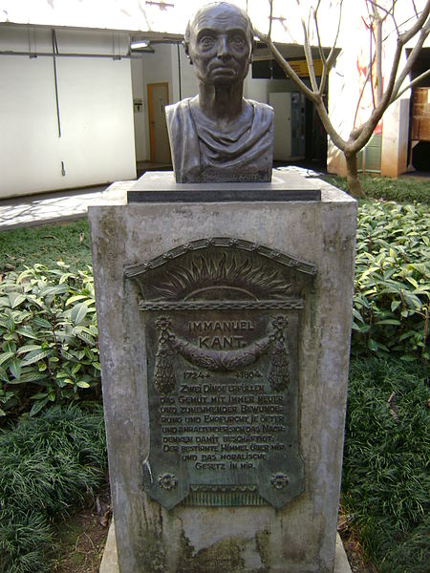
“Two things fill the heart with renewed and increasing awe and reverence the more often and the more steadily that they are meditated on: the starry skies above me and the moral law inside me.”

Slide 3
content
03
FIRST MOMENT.
Of the Judgment of Taste*: Moment of Quality.
04
SECOND MOMENT. Of the Judgment of Taste: Moment of Quantity.
01
A short introduction about Immanuel Kant
02
An introduction about Kant’s important works
Who is Immanuel Kant?
What did he experience?

Slide 4
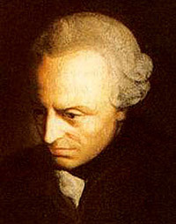
01 A short introduction about Immanuel Kant
Immanuel Kant is the central figure in modern philosophy.
He synthesized early modern rationalism and empiricism, set the terms for much of nineteenth and twentieth century philosophy, and continues to exercise a significant influence today in metaphysics, epistemology, ethics, political philosophy, aesthetics, and other fields.
Immanuel Kant (1724–1804)

Slide 5
01 A short introduction about Immanuel Kant
Birthplace——Königsberg
Family——artisan family of modest means，
trade in decline
Education——
the Collegium Fridericianum(a Pietist school);
the University of Königsberg(known as the Albertina) Academic career

Slide 6
01 A short introduction about Immanuel Kant
Academic career——
six years as a private tutor to young children outside Königsberg；
teaching at the Albertina；(1754—1796)
had a burst of publishing activity during that time.
natural philosophy moral philosophy

Slide 7
content
01
A short introduction about Immanuel Kant
02
An introduction about Kant’s important works
03
FIRST MOMENT.
Of the Judgment of Taste*: Moment of Quality.
04
SECOND MOMENT. Of the Judgment of Taste: Moment of Quantity.
Critique of Pure Reason
Critique of Practical Reason
Critique of Judgement

Slide 8
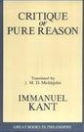
02 An introduction about Kant’s important works
First: Critique of Pure Reason
Human understanding is the source of the general laws of nature that structure all our experience.

Slide 9
02 An introduction about Kant’s important works
Second: Critique of Practical Reason
Human reason gives itself the moral law, which is our basis for belief in God, freedom, and immortality

Slide 10
02 An introduction about Kant’s important works
Third: Critique of Judgement
The bridge between the moral man and the scientific man.

Slide 11
content
01
A short introduction about Immanuel Kant
02
An introduction about Kant’s important works
03
FIRST MOMENT.
Of the Judgment of Taste*: Moment of Quality.
04
SECOND MOMENT. Of the Judgment of Taste: Moment of Quantity.
Why is “quality” first?

Slide 12
03 FIRST MOMENT. Of the Judgment of Taste*: Moment of Quality.
What is required for calling an object beautiful ?
To which moments attention is paid by this judgment in its reflection?
Quality is what the aesthetic judgment on the beautiful looks to in the first instance

Slide 13
03 FIRST MOMENT. Of the Judgment of Taste*: Moment of Quality.
§1.The judgment of taste is aesthetic.
To discern whether anything is beautiful or not
By means of the imagination we refer the representation to the subject and its feeling of pleasure or displeasure.
The judgment of taste, therefore, is not a cognitive judgment, and so not logical, but is aesthetic—which means that it is one whose determining ground cannot be other than subjective.

Slide 14
03 FIRST MOMENT. Of the Judgment of Taste*: Moment of Quality.
§2. The delight which determines the judgment of taste is independent of all interest.
All one wants to know is whether the mere representation of the object is to my liking, no matter how indifferent I may be to the real existence of the object of this representation.
whether we are, or even could be, concerned in the real existence of the thing
what estimate we form of it on mere contemplation (intuition or reflection)
One must not be in the least prepossessed in favour of the real existence of the thing, but must preserve complete indifference in this respect, in order to play the part of judge in matters of taste

Slide 15
03 FIRST MOMENT. Of the Judgment of Taste*: Moment of Quality.

Slide 16
03 FIRST MOMENT. Of the Judgment of Taste*: Moment of Quality.
§3. Delight in the agreeable is coupled with interest.
the senses find pleasing in sensation
we do not merely say of the agreeable that it pleases, but that it gratifies
referred solely to the subject and is not available for any cognition, not even for that by which the subject cognizes itself
The green color of the meadows belongs to objective sensation, as the perception of an object of sense; but its agreeableness to subjective sensation, by which no object is represented

Slide 17
03 FIRST MOMENT. Of the Judgment of Taste*: Moment of Quality.
§4. Delight in the good is coupled with interest.
by means of reason commends itself by its mere concept
end the relation of reason to willing
a delight in the existence of an object or action some interest or other

Slide 18
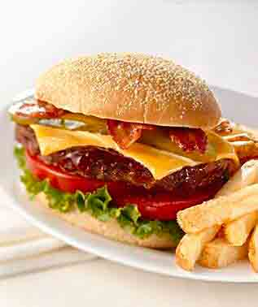
03 FIRST MOMENT. Of the Judgment of Taste*: Moment of Quality.
Delight in the beautiful must depend upon the reflection on an object precursory to some (not definitely determined) concept.
It is thus also differentiated from the agreeable, which rests entirely upon sensation.
Only by what a man does heedless of enjoyment, in complete freedom, and independently of what he can procure passively from the hand of nature, does be give to his existence, as the real existence of a person, an absolute worth. Happiness, with all its plethora of pleasures, is far from being an unconditioned good
The good VS The agreeable
mediately or immediately good;
what pleases immediately, like the beautiful

Slide 19
03 FIRST MOMENT. Of the Judgment of Taste*: Moment of Quality.
§5. Comparison of the three specifically different kinds of delight.
The good | The agreeable | The beautiful
a delight pathologically conditioned | a pure practical delight | simply contemplative
what is ESTEEMED (approved) | what GRATIFIES a man | what simply PLEASES him
every rational being in general | irrational animals | only for human beings

Slide 20
03 FIRST MOMENT. Of the Judgment of Taste*: Moment of Quality.
Definition of the Beautiful derived from the First Moment:
Taste is the faculty of estimating an object or a mode of representation by means of a delight or aversion apart from any interest.
The object of such a delight is called beautiful.
Delight of taste in the beautiful may be said to be the one and only disinterested and free delight

Slide 21
content
01
A short introduction about Immanuel Kant
02
An introduction about Kant’s important works
03
FIRST MOMENT. Of the Judgment of Taste*: Moment of Quality.
04
SECOND MOMENT. Of the Judgment of Taste: Moment of Quantity.

Slide 22
04 SECOND MOMENT. Of the Judgment of Taste: Moment of Quantity.
§6. The beautiful is that which, apart from concepts, is represented as the Object of a universal delight.
The judgement of taste, with its attendant consciousness of detachment from all interest, must involve a claim to validity for all men, and must do so apart from universality attached to objects, i.e., there must be coupled with it a claim to subjective universality.

Slide 23
04 SECOND MOMENT. Of the Judgment of Taste: Moment of Quantity.
§7. Comparison of the beautiful with the agreeable and the good by means of the above characteristic.
The good | The agreeable | The beautiful
represented as an object of universal delight by means of a concept | restricted merely to himself personally; every one has his own taste (that of sense) | as if it were a property of things; demands this agreement of all man

Slide 24
04 SECOND MOMENT. Of the Judgment of Taste: Moment of Quantity.
§8. In a judgement of taste the universality of delight is only represented as subjective.
The judgement of taste
a objective universal validity
The taste of sense
The taste of reflection
laying down judgements merely private
judgements ostensibly of general validity (public)
a subjective universal validity

Slide 25
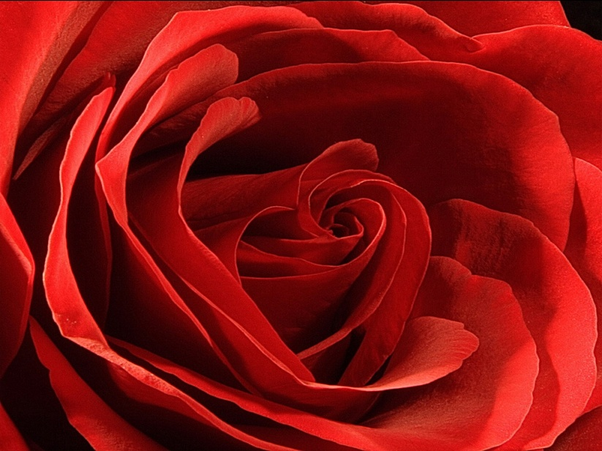
04 SECOND MOMENT. Of the Judgment of Taste: Moment of Quantity.
Nothing is postulated in the judgement of taste but such a universal voice in respect of delight that it is not mediated by concepts; consequently, only the possibility of an aesthetic judgement capable of being at the same time deemed valid for everyone
In their logical quantity, all judgements of taste are singular judgements
The judgement of taste itself does not postulate the agreement of everyone ;it only imputes this agreement to everyone, as an instance of the rule in respect of which it looks for confirmation, not from concepts, but from the concurrence of others

Slide 26
04 SECOND MOMENT. Of the Judgment of Taste: Moment of Quantity.
§9. Investigation of the question of the relative priority in a judgement of taste of the feeling of pleasure and the estimating of the object.
This purely subjective (aesthetic) estimating of the object, or of the representation through which it is given, is antecedent to the pleasure in it, and is the basis of this pleasure in the harmony of the cognitive faculties

Slide 27
04 SECOND MOMENT. Of the Judgment of Taste: Moment of Quantity.
In a judgement of taste, of a reciprocal subjective common accord of the powers of cognition.
Is it aesthetically by sensation and our mere internal sense?
Or is it intellectually by consciousness of our intentional activity in bringing these powers into play?

Slide 28
04 SECOND MOMENT. Of the Judgment of Taste: Moment of Quantity.
Definition of the Beautiful drawn from the Second Moment.
The beautiful is that which, apart from a concept, pleases universally.

Slide 29
The end
Thanks for your attention!

