Slide 1
严肃游戏设计—— Lab-Adventure
09300300080 卜旸

Slide 2
游戏类型
解谜游戏
举例：神秘视线
神秘视线（Mystery Case Files）是一部由 Bigfish Games 出品的冒险解谜系列，游戏的口号是 You Be the Detective，玩家作为侦探，根据英文提示找出相对应的东西，使用丰富的道具，解开相应的谜题，破解诡异的机关。

Slide 3
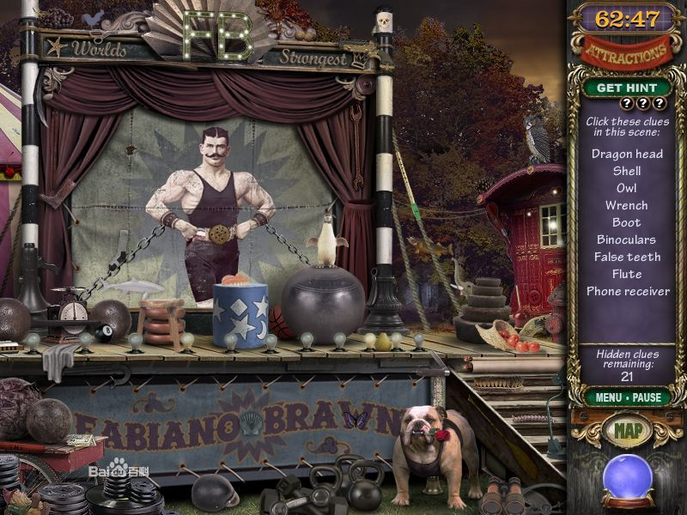
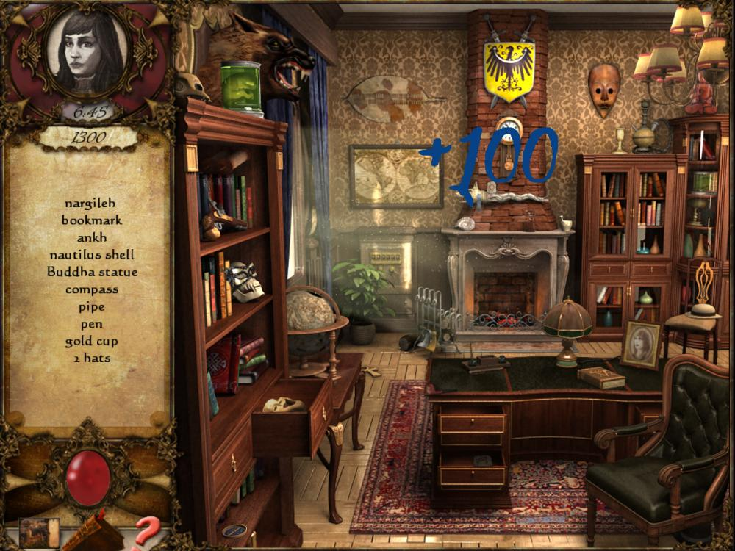
神秘视线9：影子湖mystery case films.shadow lake2012年11月20日发布。
1973年，一个在Bitterford, Maine的囚犯在不知情的情况下出土了一个神秘的被诅咒的古物。随后，监狱长，监狱长的儿子，老师，医生，警察，牧师先后接触了这个古物，但都神秘死去。
现今，Bitterford变成了一座空城，你必须合力与Cassandra Williams一起解开这座城市被破坏的原因。并且找到这个古物，破解它的诅咒，并且把它藏在一个谁也拿不到的地方

Slide 4
严肃游戏前期分析
游戏对象分析：
任何对解谜游戏感兴趣的人。
需要具有一定的科学技术认知能力。
学习目标分析：
从游戏中接触实验室设备，从而建立对实验设备有一定了解与认识。
在社区交流中获得对自己实验室布局的一些建议。
学习内容分析

Slide 5
游戏设计主体内容
生存模式
自由模式
导师模式

Slide 6
Survive mode
Background Story:
During an experimental failure (e.g. the hydrogen leaks), the facilities of the laboratory come into a mess, even stuck the lab’s door, so you cannot get outside of the laboratory. Thus, you have to put everything into order and find the key (maybe under one of the machines) to the door.
Scene:
In the laboratory. 3D
Tasks:
Put each facility into order and find the key, so you can get out.
Details Instructions:
Each facility you click/choose will lead to an introduction of the facility, and then appears a question about the facility. If you choose the correct answer, then you will get bonus scores; if you choose the wrong answer, the time for you to get out the room will decrease (when time runs out, you died). For each facility you click, after you answer the question, whether correct or incorrect, you will have a chance to find the key to the door. Once you get the key, you win.

Slide 7
Something about the stage:
In the survive mode, the difficulty will increase after you complete each stage.
You need enough scores to unlock new stage.
The difficulties:
1. More facilities added.
2. Some common tools added such as scissors, spanner.
3. Harder questions to answer.
4. Shorter time for you to find the key.

Slide 8
Free mode
Introduction: You will get a random lab room and you can click the machines of the room to get information of it, the same as the survive mode, you will get a question of the machine, and get bonus scores after you choose the correct answer. But there is no need to find the key, or time limit in this mode. But the score you acquired in this mode can be used in other modes.

Slide 9
Supervisor mode
In this mode, the player’s role will be a supervisor.
What can the supervisor do?
Set up the facility or machine in a lab room.
Edit the information of the facilities of the lab.
Upload the arrangement of the machines in the lab.

Slide 10
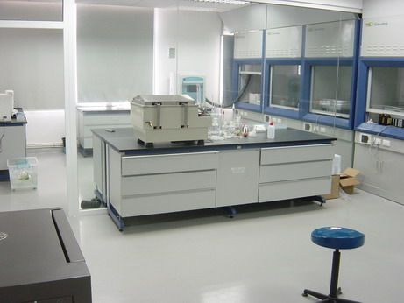
游戏界面
Scores: 8000
Survive mode
stage1
Stage2
(2000pt unlock)
Free mode
Supervisor mode
Stage4
(4000pt unlock)
Stage3
(3000pt unlock)

