Slide 1
Unit 9 Medical Education
College English Center
College of Foreign Languages and Literature
Fudan University
Page 211 -235

Slide 2
Issues to be covered
The personal attributes necessary for a medical professional
The way medical schools are ranked
The terms referring to a medical professional in his various stages of training and medical practice
The necessary steps to become a medical professional in USA
Page 211 -235

Slide 3
What makes a good doctor?
knowledge
expertise
skill
compassion
devotion
patience
perseverance
caring
altruism
Samaritanism
sacrifice
love
humanism
morality
Watch the video and check against the list!
What makes a good doctor – street interview
Page 212

Slide 4
Text A
What Does it Mean to be a Physician?
Michael E. Whitcomb
Page 212

Slide 5
How do you comment on the medical courses you have taken and you are taking?
Page 190

Slide 6
Give examples to illustrate changes that have occurred in medical school curriculum? (Pre. 1)
The addition of programs to current curriculum
“Medical Humanities”
“Physician-Patient Communication"
"Social and Cultural Issues in Health Care“
More in your curriculum?
Page212, P1

Slide 7
Give examples to illustrate changes that have occurred in medical school curriculum? (Pre. 1)
What lies behind such changes?
A reflection of a commitment by medical school deans and faculties to better prepare their students for the challenges they will face throughout their professional careers.
Page212, P1

Slide 8
Language Focuses
for / to meet
to better prepare their students __________ the challenges they will face throughout their professional careers.
The changes that have been adopted are truly impressive, yet there is still more to be accomplished.
on several occasions
医学教育界
the medical education community
Page 212, P1

Slide 9
What is the primary purpose of medical education? (Pre. 2)
For students to learn, in depth, what it means to be a physician
Upon graduation, have an understanding of what it means to be a physician when they receive the title / are bestowed with the title
have the personal qualities for a physician to be capable of meeting the public’s expectations of a doctor
Page 122, P2

Slide 10
Language Focuses
深刻了解
for students to learn, in depth,…
深刻理解/领悟/反省
to understand / perceive / reflect, in depth,…
to have a deeper understanding / perception / reflection
Page 122, P2

Slide 11
Language Focuses
what it means to be
a physician
a nurse
pharmacologist
scientist
English teacher
Page 122, P2

Slide 12
Language Focuses
the actual practice of medicine
Even so,…
My intent, instead, is to seek agreement within the medical education community on the attributes
求同存异
seek agreement while shelving differences
Page 122, P2

Slide 13
Why is it wrong to equate becoming a physician with possessing a body of knowledge and a set of skills? (Pre. 3)
A body of knowledge and a set of skills
Varied requirements depending upon the particular career
Much more than a body of knowledge and a set of skills
personal attributes
to meet the public’s expectations
to define the essence of what it means to be a physician
Page 122, P3

Slide 14
Language Focuses
How many define you find in this paragraph?
a body of knowledge and a set of skills …defines what it means to be a physician.
…it is not possible to define what it means to be a physician by identifying a body of knowledge and a set of skills that all physicians must possess.
…it is those attributes that define the essence of what it means to be a physician.
Page 213, P3

Slide 15
Language Focuses
A body of knowledge and a set of skills
一身知识，一套技能？？？？
渊博的知识，出众的技艺
the particular career path a physician has chosen
I maintain all physicians should possess if they are to meet the public’s expectations
Page 213, P3

Slide 16
What did Peabody mean by saying “The secret of the care of the patient is in caring for the patient”? (Pre. 4)
the value that patients place on being truly cared for by a physician
ignorance of the importance of a caring manner
too often equated caring with treatment
limited their role to providing treatment leading to a cure
believed nothing to do done in incurable cases
Page 213, P4

Slide 17
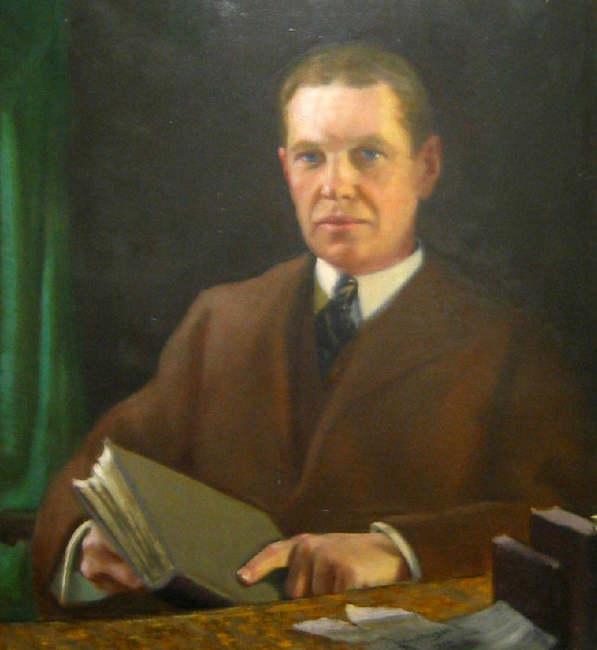
Dr. Francis Peabody
The Care of the Patient
they (the medical students) are too "scientific" and do not know how to take care of patients.
Page 213, P4

Slide 18
Language Focus
describe in eloquent terms the value that patients place on being truly cared for by a physician.
members of the medical profession
have too often equated caring with treatment, and have tended at times to limit their
equate A with B
Don’t equate being free of illness with health.
Page 213, P4

Slide 19
The Goals of Medicine: Hastings Center’s project
(1) the prevention of disease and injury and the promotion and maintenance of health;
(2) the relief of pain and suffering caused by maladies;
(3) the care and cure of those with a malady and the care of those who cannot be cured;
(4) the avoidance of premature death and the pursuit of a peaceful death
Page 215, P5

Slide 20
the care and cure of those with a malady and the care of those who cannot be cured
a responsibility to continue to care for their patients when they can no longer prescribe a particular form of treatment or offer the likelihood of a cure
if not, not being caring—their patients will sense that they have been abandoned by their doctor at a critical time.
Page 215, P5

Slide 21
Why must a physician be inquisitive? (Pre. 5)
a long tradition of celebrating knowledge, but
a great deal about medicine that is not known
a great deal that individual physicians do not know about what is known.
Page 214, P6

Slide 22
The long tradition of celebrating knowledge (Pre. 5)
All that the members of the profession know about mechanisms of disease and the diagnosis and management of various clinical maladies
What you know makes a difference.
Page 214, P6

Slide 23
Language Focus
various clinical maladies
admission to the study of medicine
advancement throughout the various stages of one’s career
Page 214, P6

Slide 24
the value of physicians’ being inquisitive
Great contribution to the quality of care
Insurance of continuous acquisition of the knowledge and skills they will need to meet their professional responsibilities as the nature of medicine changes during their careers
Page 214, P7

Slide 25
Jerome Groopman’s book: How Doctors Think
Most of the diagnostic errors made by physicians result from cognitive mistakes.
Do you agree or disagree? Why?
Page 214, P8

Slide 26
Jerome Groopman’s book: How Doctors Think
?
?
?
Page 214, P8

Slide 27
Jerome Groopman’s book: How Doctors Think
uncertainty inherent in the practice of medicine
a tendency to lock in on a particular diagnosis or a particular approach to treatment
risk of overlooking clues suggesting incorrect working diagnosis
Page 214, P8

Slide 28
Jerome Groopman’s book: How Doctors Think
So what?
True physician always pauses before making a diagnosis and embarking on a course of therapy
What I don’t understand?
Or, importantly, What I should know before proceeding?
Page 214, P8

Slide 29
Language Focus
锁定
to lock in on…
run the risk of…
embark on a course of therapy
Page 214, P8

Slide 30
What is the civic responsibility of a physician? (Pre. 6)
More personal involvement in meeting medicine’s responsibility to society
Concerning themselves with ensuring that their professional organizations are focused on serving the interests of the public
Conscious contribution in a variety of ways to the betterment of the communities they live in
by participating in community organizations
by bringing their special talents to bear in volunteer efforts specifically aimed at improving the health of the public.
Page 214-5, P 9

Slide 31
Language Focus
…a confusing concept …, because …the civic responsibility of the individual physician tends to be obscure.
Page 214, P9

Slide 32
Language Focus
Over the years, this responsibility has come to be viewed as an element of professionalism that is somehow embedded, at least implicitly, within the context of the social contract that defines the medical profession’s responsibility to the society as a whole—a responsibility manifested largely by how professional organizations relate to the public.
Page 215, P9

Slide 33
Language Focus
meeting medicine’s responsibility to society
serving the interests of the public
the civic mindedness of physicians should go beyond that to include
发挥他们的特殊才干，做些志愿者应该做的工作…
bringing their special talents to bear in volunteer efforts
Page 214-5, P9

Slide 34
To Sum Up
a physician not caring, inquisitive, and civic minded may be a highly skilled technician involved in the practice of medicine, such an individual will not truly reflect the essence of what it means to be a physician
medical schools continue to modify their educational programs to reflect a commitment to ensuring that their graduates be caring, inquisitive, and civic-minded physicians
Page 215, P10

Slide 35
To Sum Up
Qualities of a true physician
much of the knowledge
many of the skills
caringness
inquisitiveness
civic-mindedness
Page 215, P10

Slide 36
Presentations for Unit 10
1. Give a brief explanation of Medicare and Medicaid. (P 243)
2. Compare the American model and the European model. (P 243)
3. What are the problems with the fragmented American health care system? (P 243)
Page 216

Slide 37
Presentations for Unit 8
4. Why is “rationalizing the medical system” the key to the present problem? (P 243)
5. Briefly summarize the four strategies. (P 243)
6. Do you support “the other voices”? Why? (P 243)
Page 195

