Slide 1
Unit 6 Life and Medicine
College English Center
College of Foreign Languages and Literature
Fudan University
Page 137

Slide 2
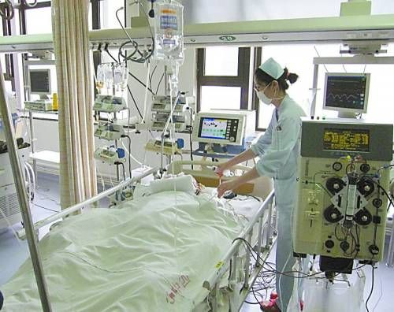
Kick-off
A Piece of News
罗瑞卿女儿推动尊严死亡
Page 137-166

Slide 3
Issues to be covered
Various models of end-of-life care and the commonalities and differences between them
Varied opinions on end-of-life care and euthanasia
Palliative care, hospice care, comfort care:
similarities and differences
Page 137-166

Slide 4
Text A
Finding Care at the End of Life
National Institute on Aging
Page 138

Slide 5
Text A
Finding Care at the End of Life
National Institute on Aging
Page 138

Slide 6
Lead-in
How much do you know about
hospice care
palliative care
comfort care
management care
Watch the video clip and see how hospice care is defined.
Hospice philosophy of death
Page 136

Slide 7
Lead-in
Hospice Philosophy Regarding Death
General Concept
?
Home Setting
?
Hospice Unit
Beautiful unit/ward to dwell / accommodate
Page 136

Slide 8
Lead-in
Hospice Philosophy Regarding Death
General Concept
Helping the right death
Making the dying as meaningful as possible
Home Setting
Making the dying as comfortable as possible
Managing symptoms by visiting nurses
Hospice Unit
Beautiful unit/ward to dwell / accommodate
Page 136

Slide 9
How has the meaning of palliative care changed? (Pre. 6)
Traditionally
Recently
only symptom care
close to hospice care
Page 140, P9-10

Slide 10
Knowledge of the subject matter
Multidisciplinary
Health Care Team
?
?
Therapists
?
?
Others
As Needed
Page 141, P11

Slide 11
Knowledge of the subject matter
Multidisciplinary
Health Care Team
Doctors
Nurses
Therapists
Counselors
Social
Workers
Others
As Needed
Page 141, P11

Slide 12
Knowledge of the subject matter
Support
?
?
?
Page 141, P11

Slide 13
Knowledge of the subject matter
Support
Medical
Social
Emotional
Page 141, P11

Slide 14
Knowledge of the subject matter
Sources
of Coverage
?
?
?
Page 141, P12

Slide 15
Knowledge of the subject matter
Sources
of Coverage
Medicare Covers
Department of Veterans Affairs for Veterans
Private Health Insurance
Providers
Page 141, P12

Slide 16
Knowledge of the subject matter
Choices/Options
in Palliative Care
Treatment
to cure a terminal disease
Comfort Care
Page 141, P13

Slide 17
Knowledge of the subject matter
Choices/Options
in Palliative Care
Hospice Care
Continued Palliative Care
with Emphasis on
Comfort Care
Page 141, P13

Slide 18
What will hospice care do?
To make
?
To manage
?
To fulfill
?
To meet
?
Page 140-141

Slide 19
What will hospice care do?
To make
the dying as comfortable as possible
To manage
the pain as well as possible
To fulfill
whatever the wishes the dying hold
To meet
whatever the needs the dying have
Page 140-141

Slide 20
Language Focuses
anemia
-emia a blood condition（血症）
leukemia
uremia
Page 140, P9-10

Slide 21
Language Focuses
Recently, the term palliative care has come to mean more than just treating symptoms.
Gradually, he has come to know his mistake.
…palliative care now often refers to a comprehensive approach to improving the quality of life for people who are living with potentially fatal diseases.
Page 140, P9-10

Slide 22
Jack as a case in point / a typical example
Retired from the U.S. Air Force
Diagnosed with chronic obstructive pulmonary disease at age seventy
More difficult breathing as the disease progressed
Able to receive the comfort care and emotional support through the palliative care provided by the Veterans Health Administration, while receiving treatment for his pulmonary disease
The palliative care program around the house and other support for Jack’s wife, making it easier for her to care for Jack at home
Page 141, P14

Slide 23
Language Focus
COPD: chronic obstructive pulmonary disease
As the disease progressed
pulmonary lung（肺）
pulmonology
pulmonitis
Page 141, P14

Slide 24
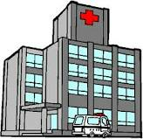
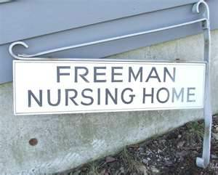
How has the end-of-life care changed over time? (Pre. 1)
Page 139, P1

Slide 25
Knowledge of the subject matter
Locations
for Palliative Care
?
?
?
?
at home
Page 141, P12

Slide 26
Knowledge of the subject matter
Locations
for Palliative Care
Hospitals
Nursing
Homes
Outpatient
Clinics
Specialized
Clinics
At home
Page 141, P12

Slide 27
There is no “right” place to die.
Things to consider when choosing the right place to die:
The most sensible type of care
Availability of such care
Availability of support system
Management of the cost
Page 139, P 2

Slide 28
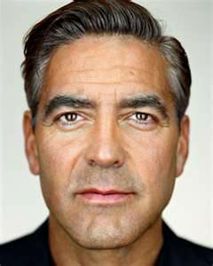
What is said about George? (Pre. 2)
AGE?
PAST HISTORY?
DECINSION ABOUT MEDICAL TREATMENT?
REQUIREMENTS ABOUT CARING SETTING?
CHOICES OF MEDICAL SERVICE?
Page 139, P2

Slide 29
What advantages does a hospital have over a nursing home for end-of-life care? (Pre. 3)
Availability of medical resources, including doctors, nurses and facility around the clock
Anything else you can add to that?
Advantages of Nursing Home
Prearranged plans for end-of-life care
Establishment of a relationship between the staff and family
More personalized care
Privacy arrangement: time alone
Page 139, P4

Slide 30
Language Focuses
临终之际/生命垂危之时/生命终了之时/弥留之际
at the end of life
生命垂危的人/临终者/弥留之际的人
the dying person
临终看护
end-of-life care
根据需要/按需
as needed
when needed??
Page 139, P 5

Slide 31
What’s the role of family and friends when the patient is cared at home? (Pre. 4)
Taking on a job which is big physically, emotionally, and financially；
Hiring a home nurse for additional help;
Arranging for services (such as visiting nurses) and special equipment (like a hospital bed or bedside commode)
Page 140 P 6-8

Slide 32
Language Focuses
来去自由
come and go freely
乐意担负一项工作
be willing to take on a job
Page 140, P 6

Slide 33
What needs to be considered to make comfort care available at home? (Pre. 5)
Health insurance
Planning by a professional, such as a hospital discharge planner or a social worker
Help from local governmental agencies
Doctor supervision at home
Page 140 P6-8

Slide 34
Linguistically and Socially
Health insurance might only cover these services or equipment if they have been ordered by a doctor.
Look at the sentence linguistically and socially.
Page 140 P 7

Slide 35
Knowledge of the subject matter
home nurse
visiting nurses
a hospital bed
bedside commode
Health insurance
hospital discharge planner
social worker
Area Agency on Aging
Page 140, P6-8

Slide 36
Does everything make any sense in China’s setting?
Nursing Home?
Palliative care?
Hospice care?
End-stage care?
Page 142, P17

Slide 37
What might be one of the misconceptions about choosing hospice? (Pre. 7)
Stopping treatment specifically aimed at curing an illness equals discontinuing all treatment
A good example: An older person with cancer
Discontinuation of chemotherapy but continuation of medication for hypertension
Page 142, P17

Slide 38
What might be one of the misconceptions about choosing hospice? (Pre. 7)
Choosing hospice is a permanent decision
Delores
Eighty-two with failing kidneys
Beginning hospice care not wanting to go through dialysis, so Delores
Changing her mind and beginning dialysis in the hopes of one day holding her first great-grandchild.
Page 142, P18

Slide 39
What might be one of the misconceptions about choosing hospice? (Pre. 7)
Choosing hospice is a permanent decision
Art Buchwald
eighty-one
real-life humorist and Washington Post columnist
Decided against the kidney dialysis suggested by his doctor
Big news with stabilized condition
Leaving hospice without threat of death
Page 142, P19

Slide 40
Language Focus
chemotherapy chemical, chemistry（化学）
chemoreceptor
chemosensory
Page 142, P17

Slide 41
Language Focus
dialysis
dia- through, across（通过）
diarrhea
diagnosis
-lysis loosening, decomposition, or breaking down（分离；分解；溶解）
cytolysis
chemolysis
Page 142, P17

Slide 42
Assignment for Group Presentation
Living wills, like euthanasia, have been legally accepted in some countries. However is it true in China? Work together with your partners and conduct a survey about it. The following prompts might be helpful to you.
Do we have living wills or something similar in China?
If so, what contents does a living will include? How are they implemented? If not, what might be the reasons for not adopting them?
Page 154

Slide 43
Presentations for Unit 7
1. What difficult situation is the young doctor facing? (P172)
2. What is paternalistic decision-making in medicine? (P172)
3. In what way can patient empowerment be good for the patient? (P172)
4. Why does the author say too much physician restraint may not be that good for the patient?(P172)
Page 172-173

Slide 44
Presentations for Unit 7
5. What kind of considerations may have prevented doctors from making decisions for their patients? (P172)
6. Do you agree that doctors should be prepared to make any decisions together with their patients? (P172)
Page 173

